Slide 1

Welcome to:
Open Forum Meeting
6 PM Wednesday, January 24, 2018
Broun Hall, Room 235

Slide 2

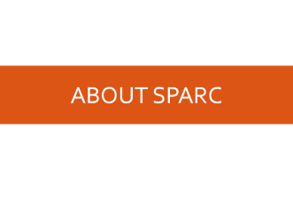
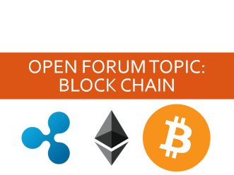
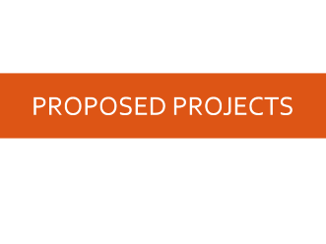
Agenda

Slide 3
About SPARC

Slide 4
Introduction
Student lead organization at Auburn University.
Creates and fosters an environment of creativity and innovation through collaborative projects.
A place to test out ideas, integrate concepts learned in class, and learn skills that will be instrumental when working in the workforce.
No prior experience is required, only a willingness to learn.
Great for students of all ages and majors.
President: Matthew Castleberry

Slide 5


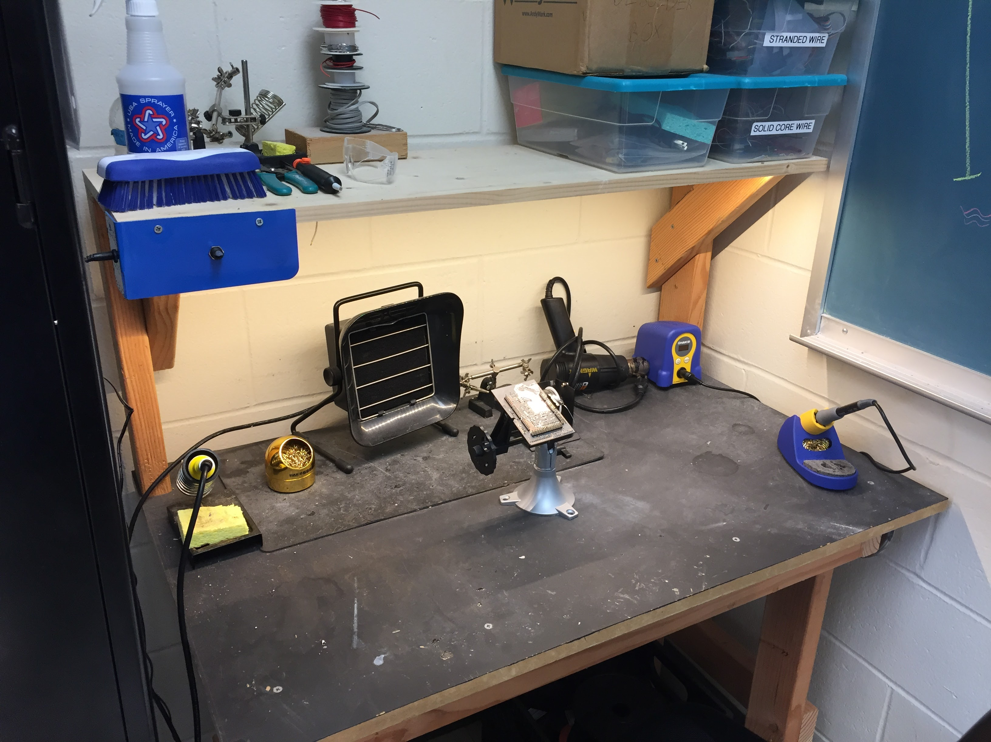
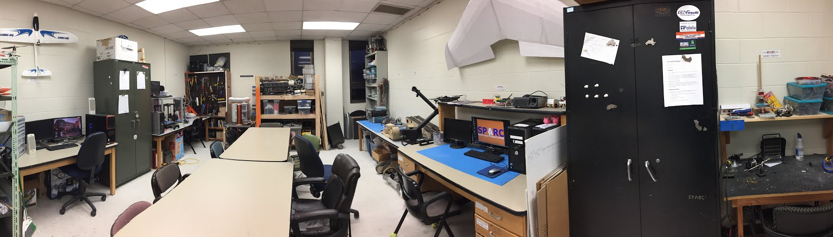
Our Lab
Broun Hall
Room: 367

Slide 6
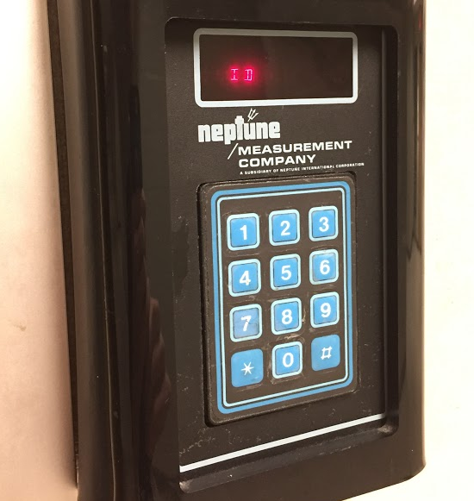
How to become a Member
Log 5 constructive hours in the lab
Write the times on the sheet on the clipboard next to the door.
Contact us at sparc.auburn@gmail.com
We will respond with the instructions to get an access code.

Slide 7
SPARC Meetings
Open Forum
Discuss status of active projects
Learn about and discuss specific topic in the realms of technology, engineering or making.
Wednesdays at 6:00 PM
Maker Training Session
Learn about a specific skills like 3D printing, CAD, electrical prototyping, and robotics.
Centered around SPARC Sumo Bot Competition
Tuesdays at 5:30 PM
Project Meetings
Project members come together to talk about detailed progress.
Meeting times and locations vary from project to project.

Slide 8
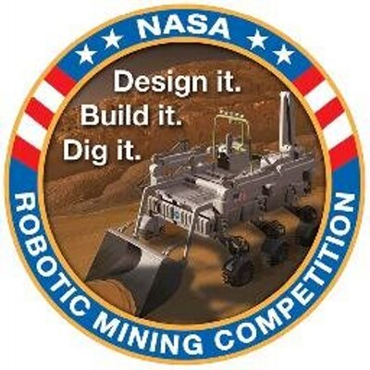

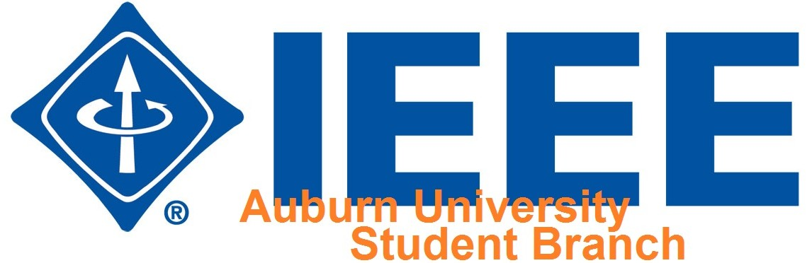
Partner Organizations
NASA Robotics Mining Competition Team
President: Jeremy Frasher <jjf0010@auburn.edu>
Meets on Mondays 6-7, SPARC Lab, Broun 367
RC Hobbyist Club
President: Craig Legrand <cbl0019@auburn.edu>
Meets on Mondays TBD and Fridays 3:30-5:00, Broun 235
IEEE Auburn University Student Branch
President: Michelle Kniffen <mek0027@auburn.edu>
Meets on Mondays 5:30-6:30, Broun 238

Slide 9




More Information about SPARC
Website
http://sparc-auburn.github.io/
Github
https://github.com/SPARC-Auburn
Slack
https://sparc-auburn.slack.com/
Email
sparc.auburn@gmail.com

Slide 10
Outreach

Slide 11
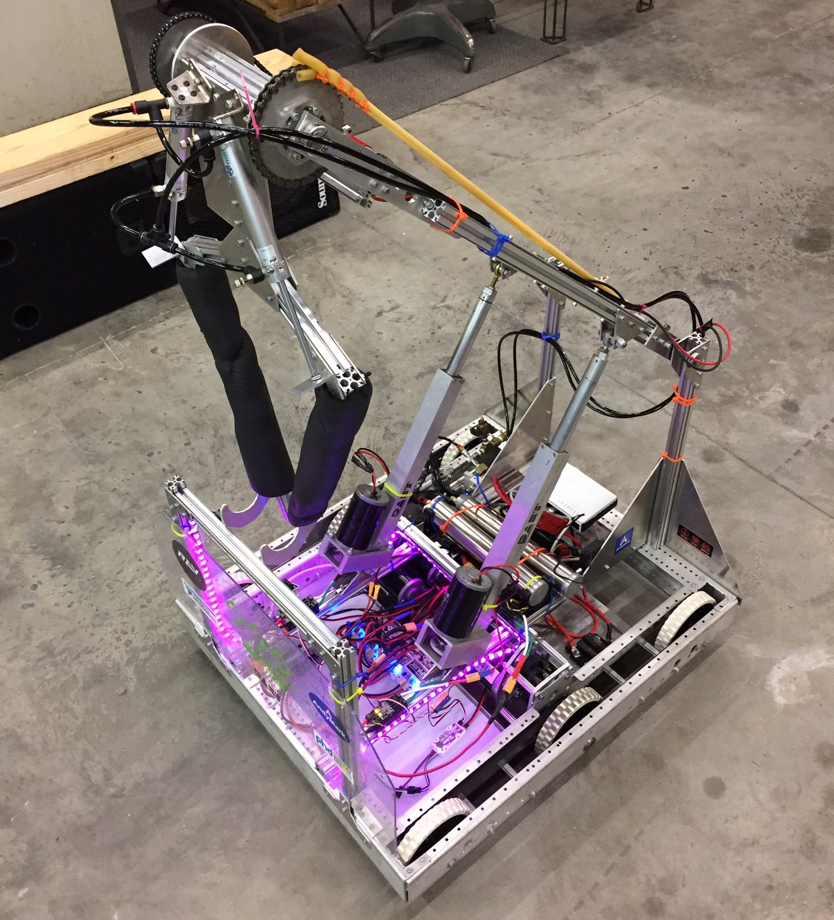
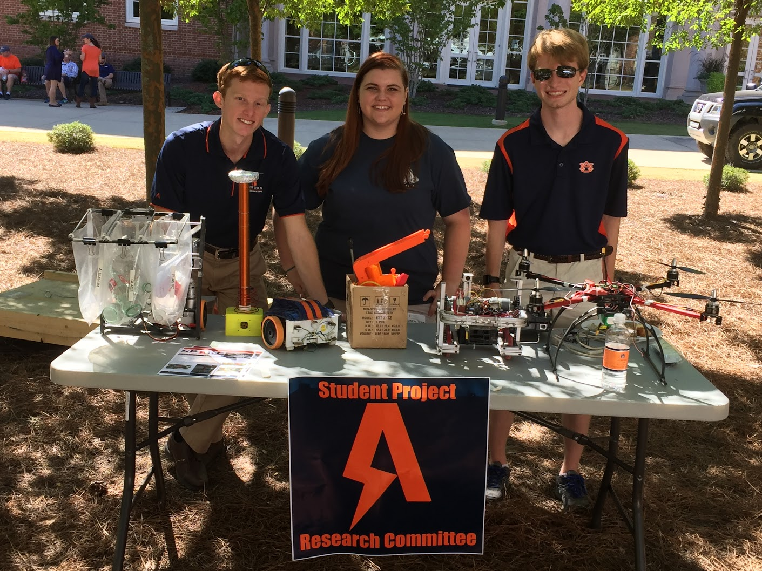
Outreach Events
Opelika HS FRC Team
Help mentor a FIRST Robotics Competition (FRC) Team
Mon Tue Thu: 3:30-6:30, Fri: 3:30-9:30, Sat:10-6
E-Day
Help display projects in Broun, Student Center, and Concourse to high school students.
Friday, February 23rd
Robot in 3 Days 2018 Bot
Engineering Tailgate 2016 SPARC Table
Notes:
Fall 2016
Loachapoka Robotics Mentoring- Mondays, Tuesdays, and Thursdays 3:00PM to 4:30PM
ECE Minority Presentation- November 14th
AJHS E-Day- November 17th
South’s Best- December 3-4th
SCORE Claw Machine- December 3-4th
Spring 2016
E-Day- Late February or early March
SPACE Day- Possible Event Next Semester
IEEE Sumo Robotics Competition (with local middle and high schools)- Spring 2017

Slide 12
Proposed Projects

Slide 13
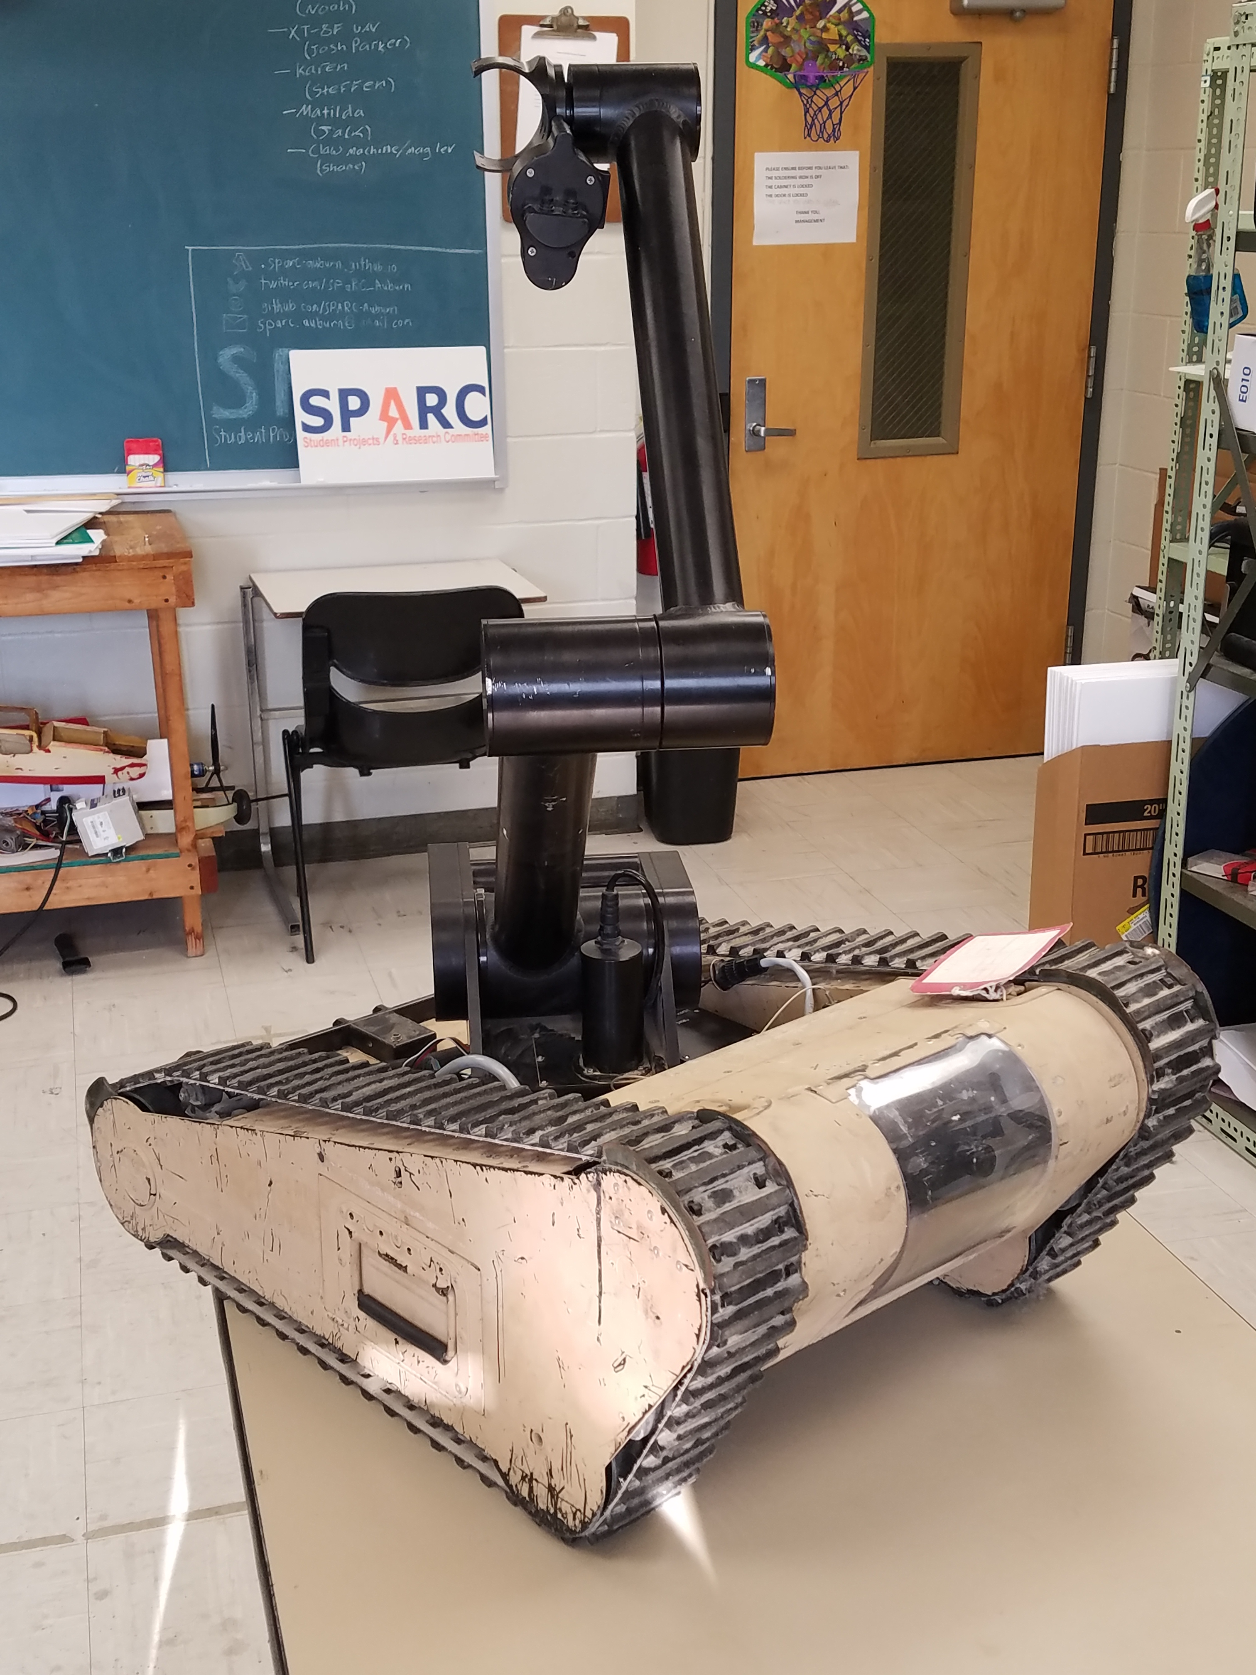
Demonstration Project: MATILDA
MATILDA stands for Mesa Associates' Tactical Integrated Light-Force Deployment Assembly
A bomb disposal robot from Dr. Roppel’s research lab.
Is in disrepair both electrically and mechanically.
Semester Focus
Reestablishing mobility.
Project Lead
Jack Thomas (jet0024@auburn.edu)
Meeting Time
Wednesdays at 12:00PM in SPARC Lab
Slack Channel
#projectmatilda

Slide 14
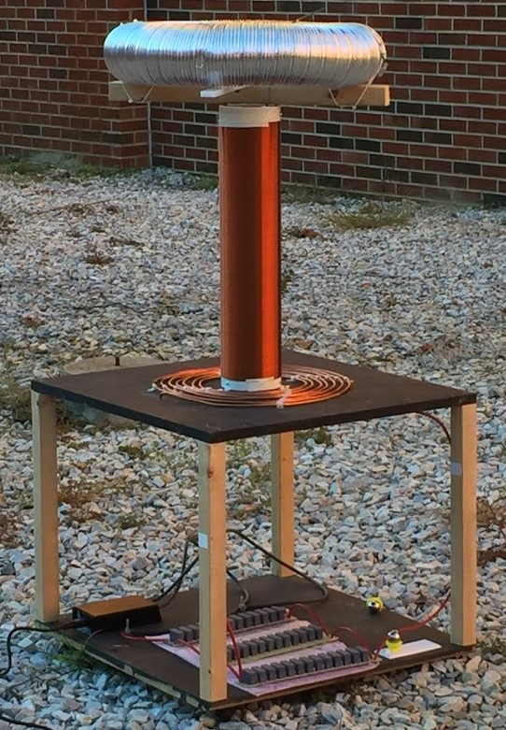
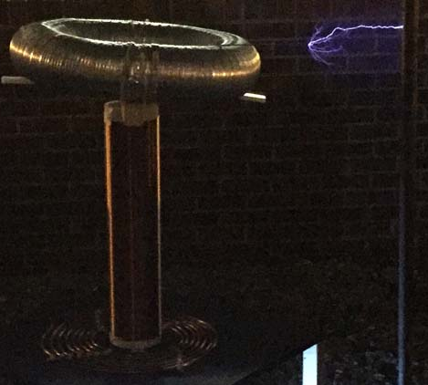

Demonstration Project: Tesla Coil
Demonstrated Tesla Coil at Spring 2016 E-Day
Use spark gap style circuitry
Generated estimated 400,000 volts of electricity.
Is in disrepair both mechanically and electrically
Semester Focus:
Make it operational again (new capacitors)
Potentially convert it into a musical Tesla Coil.
Slack Channel
#projectteslacoil

Slide 15
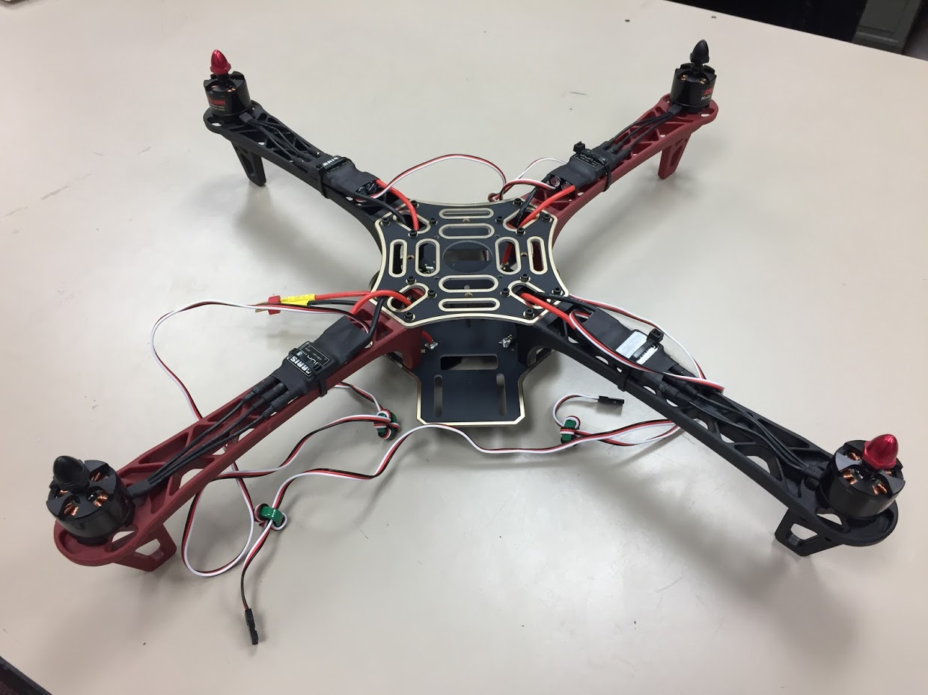
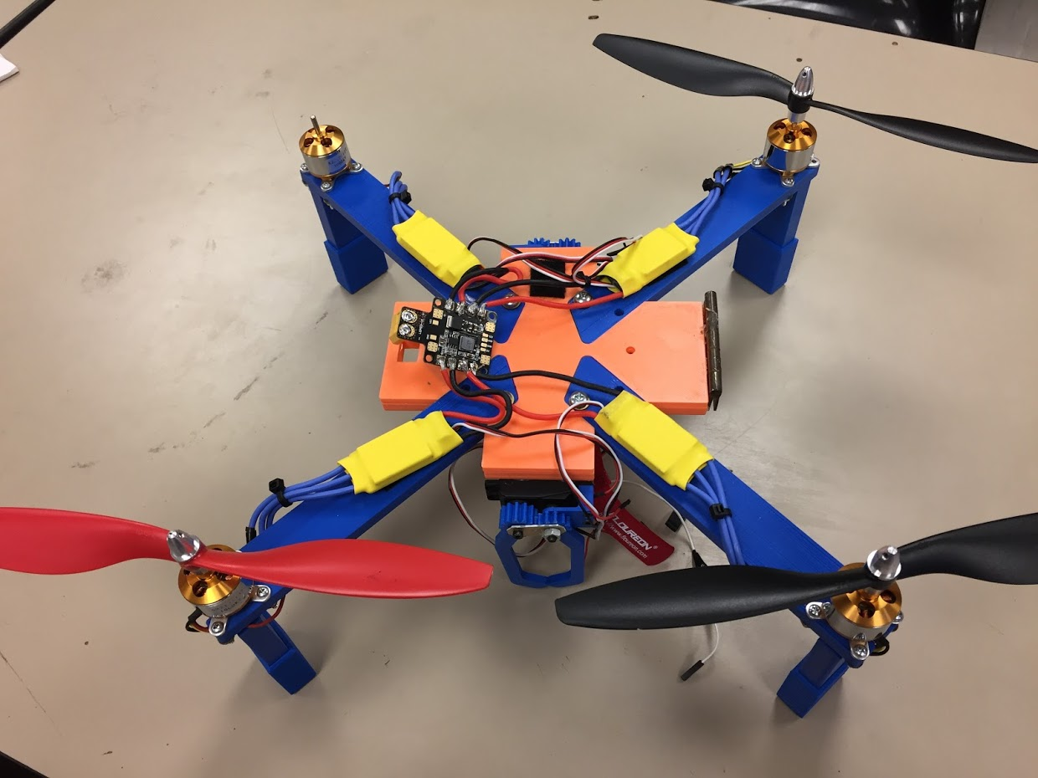
Research Project: Unmanned Aerial Systems (UAS)
Partnership with RC Hobbyist
SPARC owns two quadcopter frames.
Will be used to experiment with many applications
Autonomy- search and follow
Camera Gimbal- stable video capture
Payload- pickup, identification, and delivery
Semester Focus
Get at least one frame flying
Start looking into camera gimbal
Slack Channel
#projectuas

Slide 16
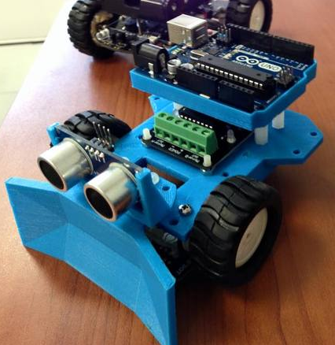
Competition Project: Sumo Robotics Tournament
Will be the final project for the Maker Training Sessions.
Attendance at Maker Training Sessions are not required to compete.
Will utilize many different topics in engineering
mechanical design
3D printing
electrical prototyping
sensor and control systems
C programming
https://www.thingiverse.com/thing:29827

Slide 17
Side Projects
Lab Assistant
Acoustic Levitator

Slide 18
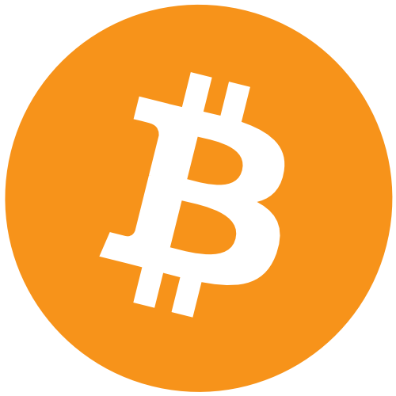


Open Forum Topic: Block Chain
Notes:
Poll room for who’s heard of currency and what they have heard about it
I don’t claim to be an expert, I’ve just read a lot about it (Give credibility)

Slide 19

Let me dispel the rumors..
Notes:
BITCOIN AND BLOCKCHAIN ARE NOT THE SAME THING
Blockchain technology is not solely a currency

Slide 20
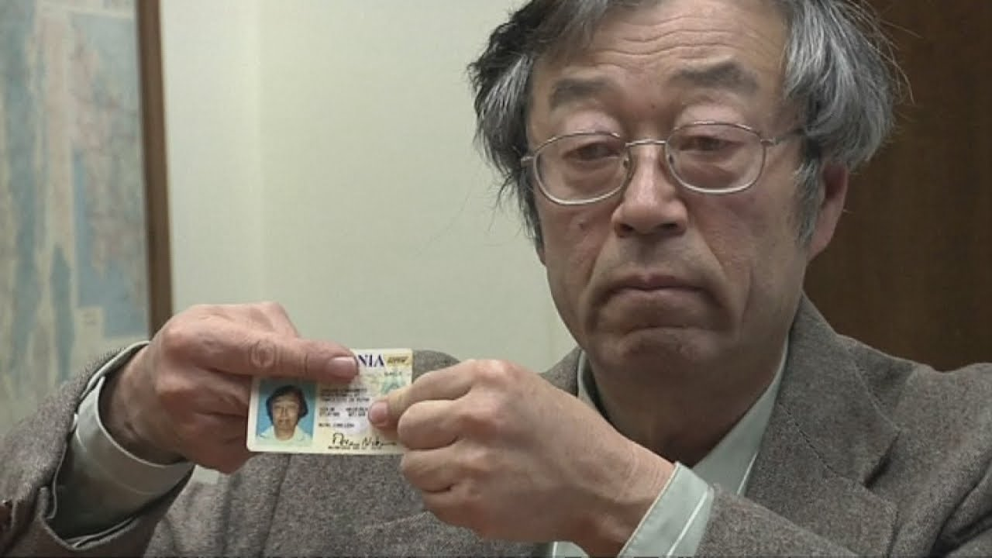
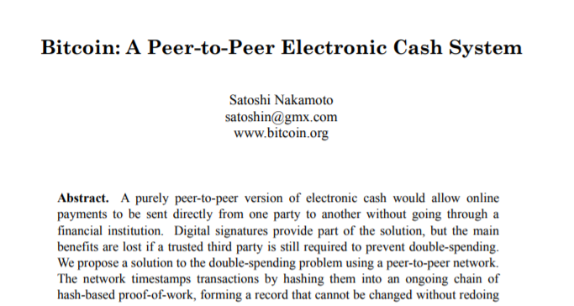
The history behind blockchain

Slide 21
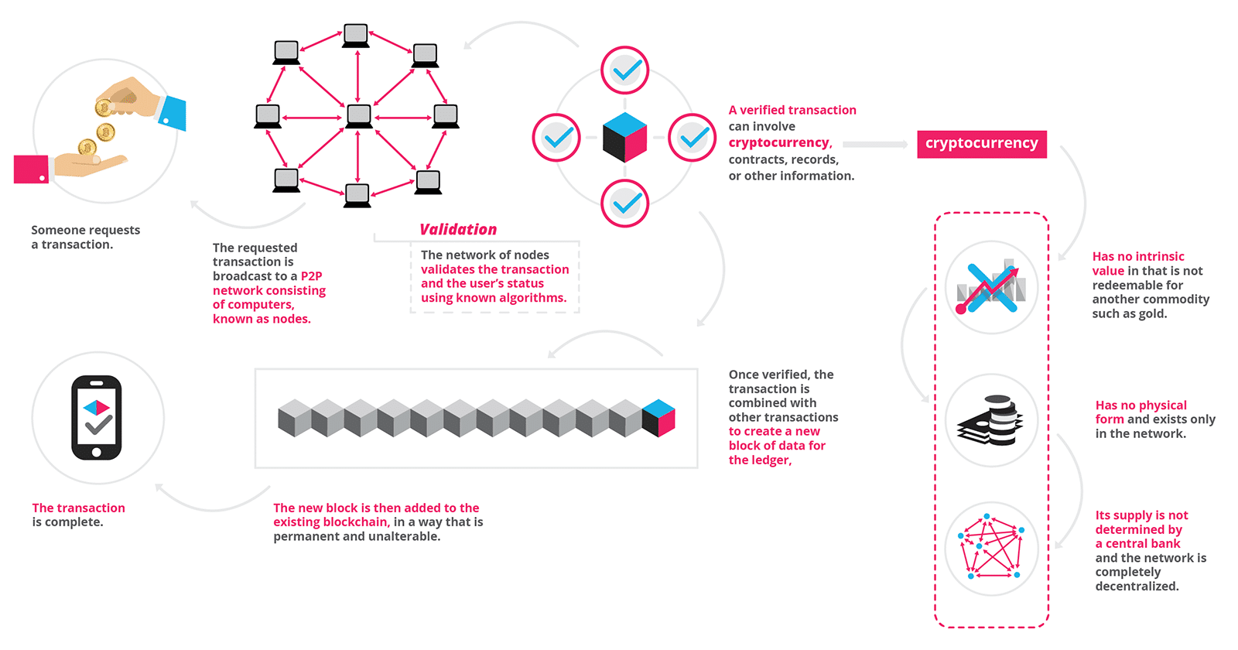
What is Block Chain?
https://blockgeeks.com/guides/what-is-blockchain-technology/
Notes:
Explain infographic
Blockchain is more or less a theory- implemented as a technology

Slide 22
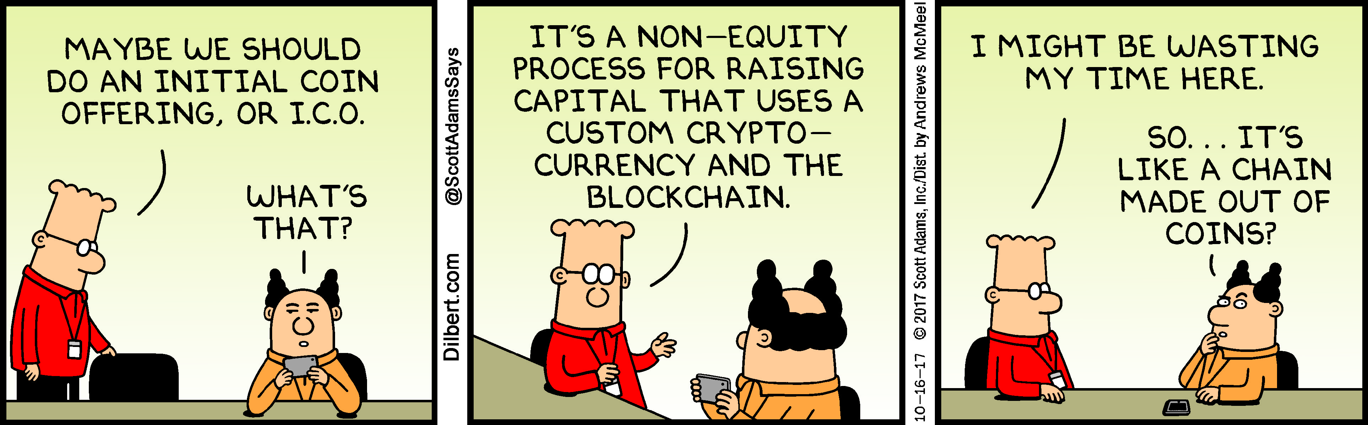
Why use blockchain?
Almost entirely decentralized
Most likely security breach is human error
Highly secure
More “power to the people”
Extended abilities as a decentralized computer

Slide 23
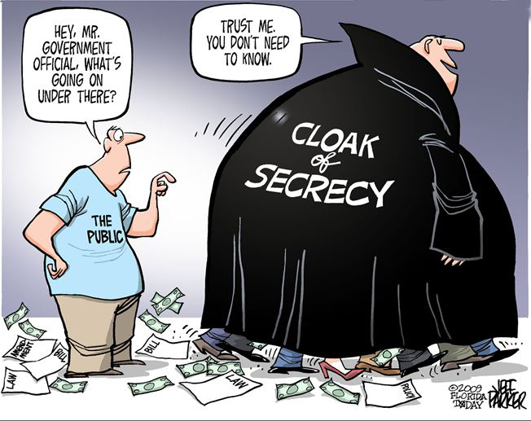
Decentralization (Pros)
No one sets the rules except for what is agreed upon by the network (Forks)
Very difficult to hack
Everything is transparent
Anonymity
Supply
Not determined by government or singular entity

Slide 24
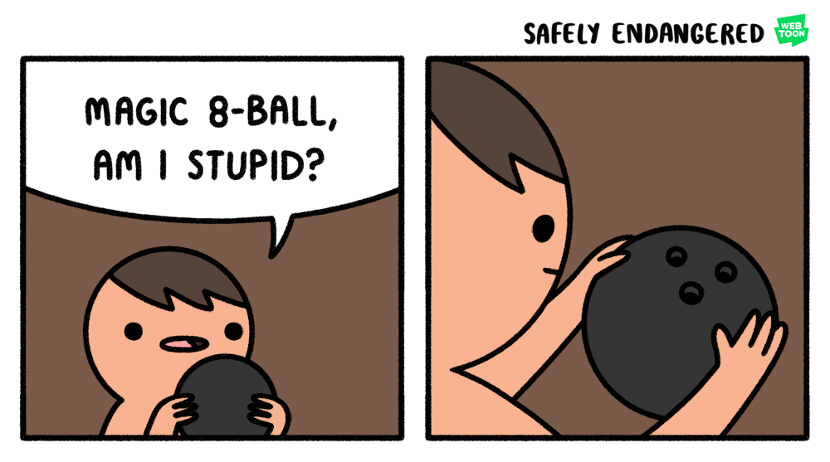
Decentralization (Cons)
Is completely dependent upon it’s users (May not exist in the far future)
Government intervention
Much of the security is dependent on the individual

Slide 25
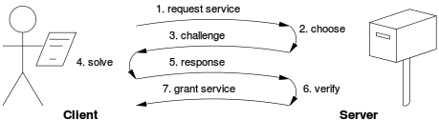
Validation (Proof of work)
Every block is a set of transactions during a certain period of time
Expensive computer calculations called “mining” validates each block in exchange for newly created currency
Cryptocurrency is not the first place POW is used

Slide 26
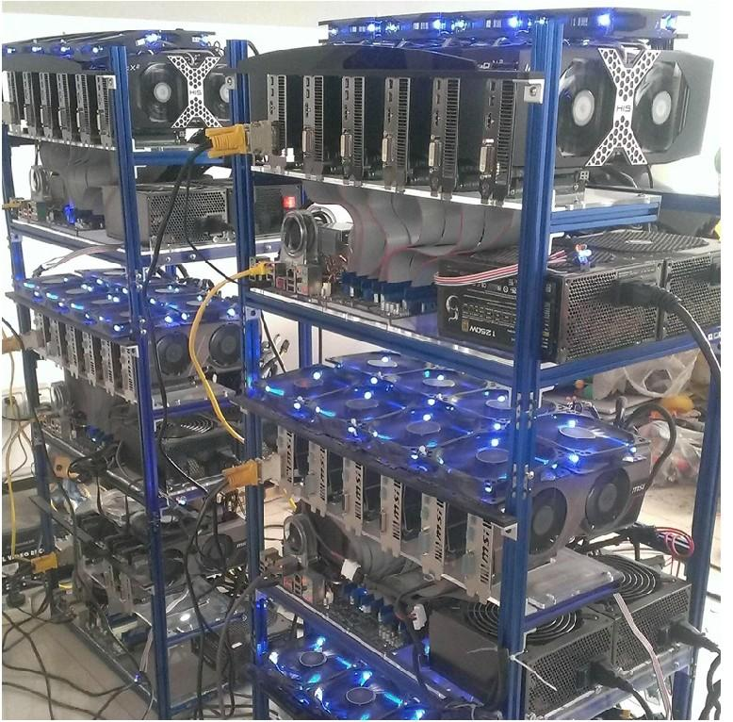
How do I mine?
Any computational component technically has the ability to mine
Power efficiency is an important variable
Different currencies require different equipment

Slide 27
(PoW) Pros and cons
In 2015, statistics say 1.5 American households could have been powered in one day with the power it took to mine one Bitcoin. (https://blockgeeks.com/bitcoins-energy-consumption/)
Very secure- as an attack would require more resources than would likely be gained
Is difficult to scale, average block time of Bitcoin is now 10 minutes
Vulnerable to a 51% attack

Slide 28
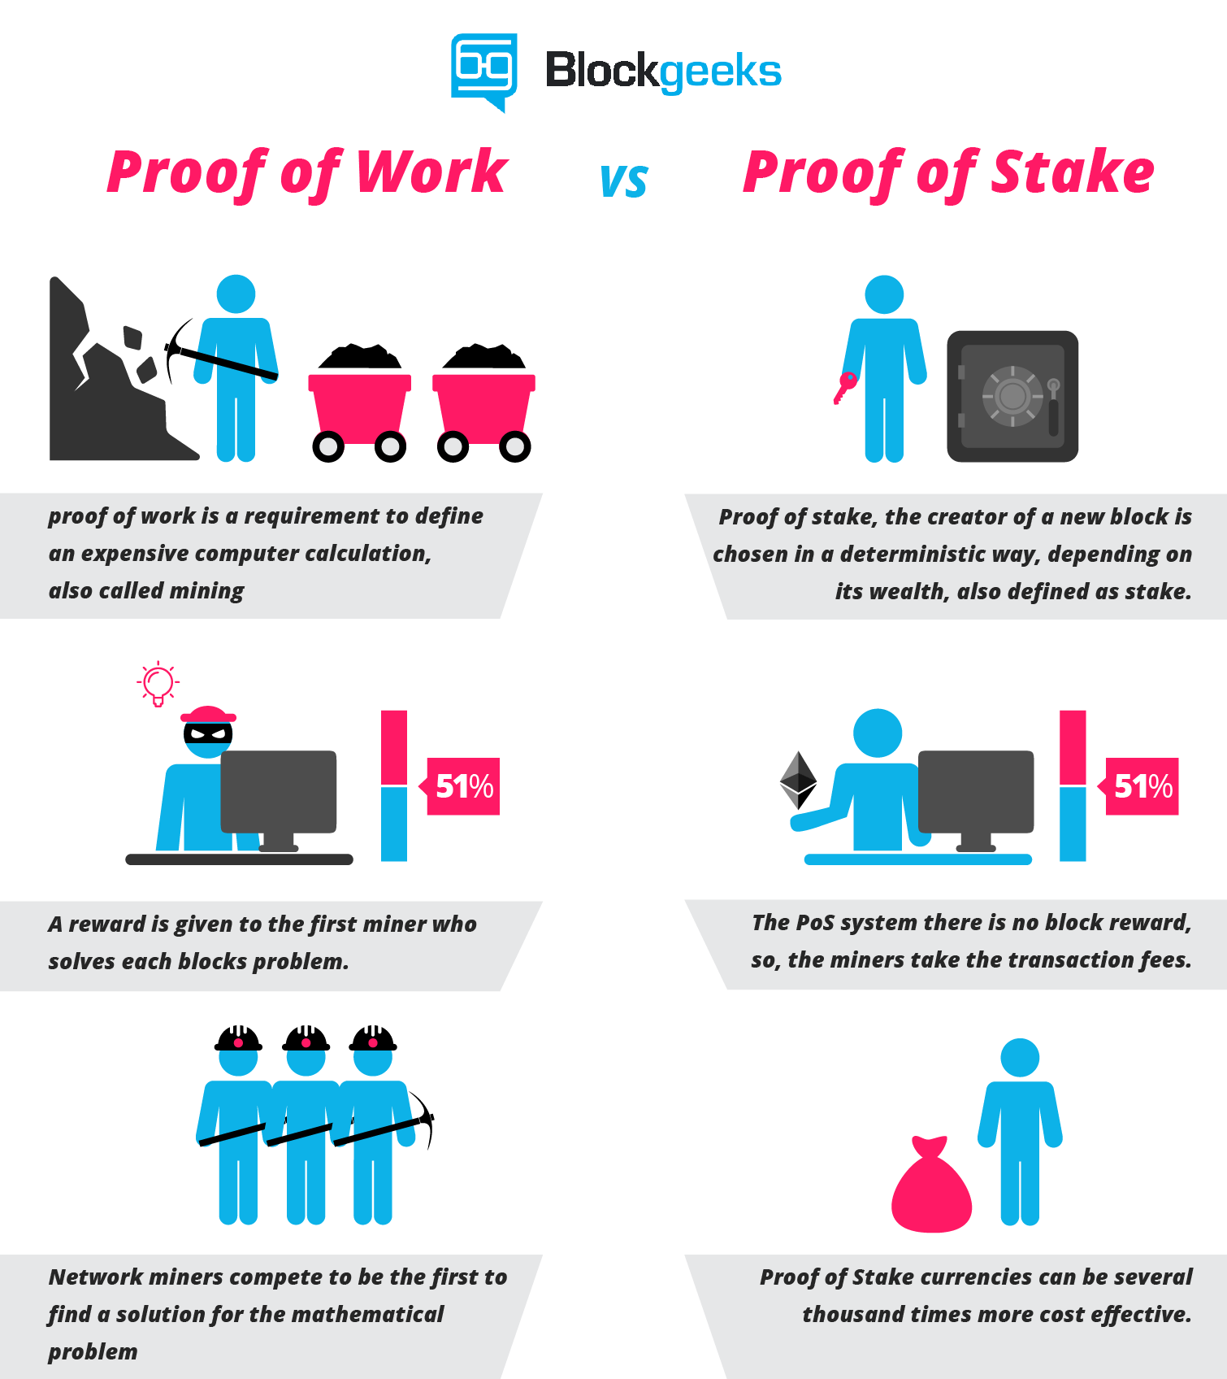
Validation (Proof of stake)
Instead of requiring tons of guessing and large amounts of computational power, the new “forger” could be chosen by the network
This forger is chosen at random based on how much stake they have in the network
If any validator is found to have an invalid block, their “stake” is removed

Slide 29
(POS) Pros and cons
The initial code must be bulletproof- since it will be the weakest point in the system
Massive energy savings- you would only need a running laptop to participate as a validator
More individuals would be encouraged to hold the currency, as staking it increases their take
Removes the insecurity issue of 51%

Slide 30
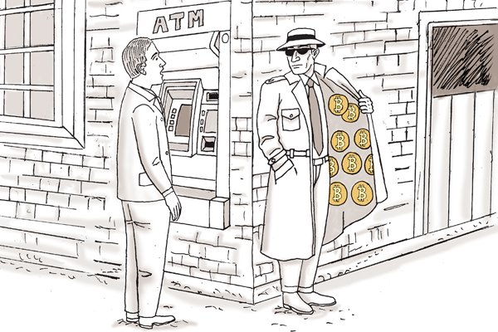
Bitcoin
Widely known as the first “cryptocurrency” built on the blockchain and, at times, is considered synonymous
Meant to be just that- a currency and not much more
Changes to the currency are very difficult (e.g Bitcoin Cash)

Slide 31
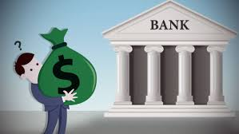
Ripple
Growing in popularity
Very fast transaction times
Primary purpose is to save transaction time and costs between banks
Great for international transfers

Slide 32
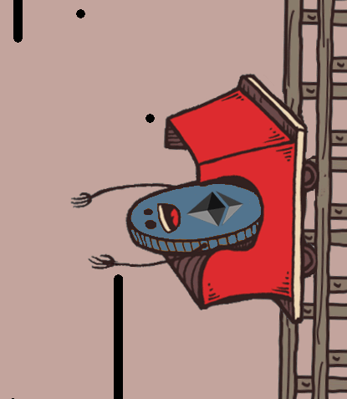
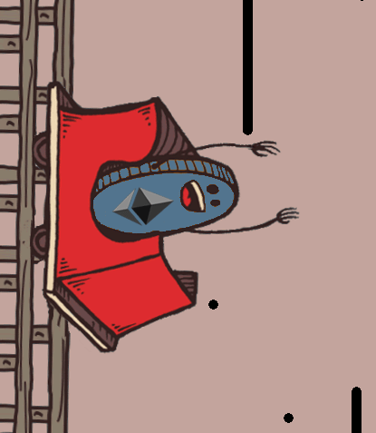
Ethereum
My personal favorite – probably the most popular currency with the most utility
A Turing Complete programming language
Every address has the ability to run code on it – or smart contracts

Slide 33
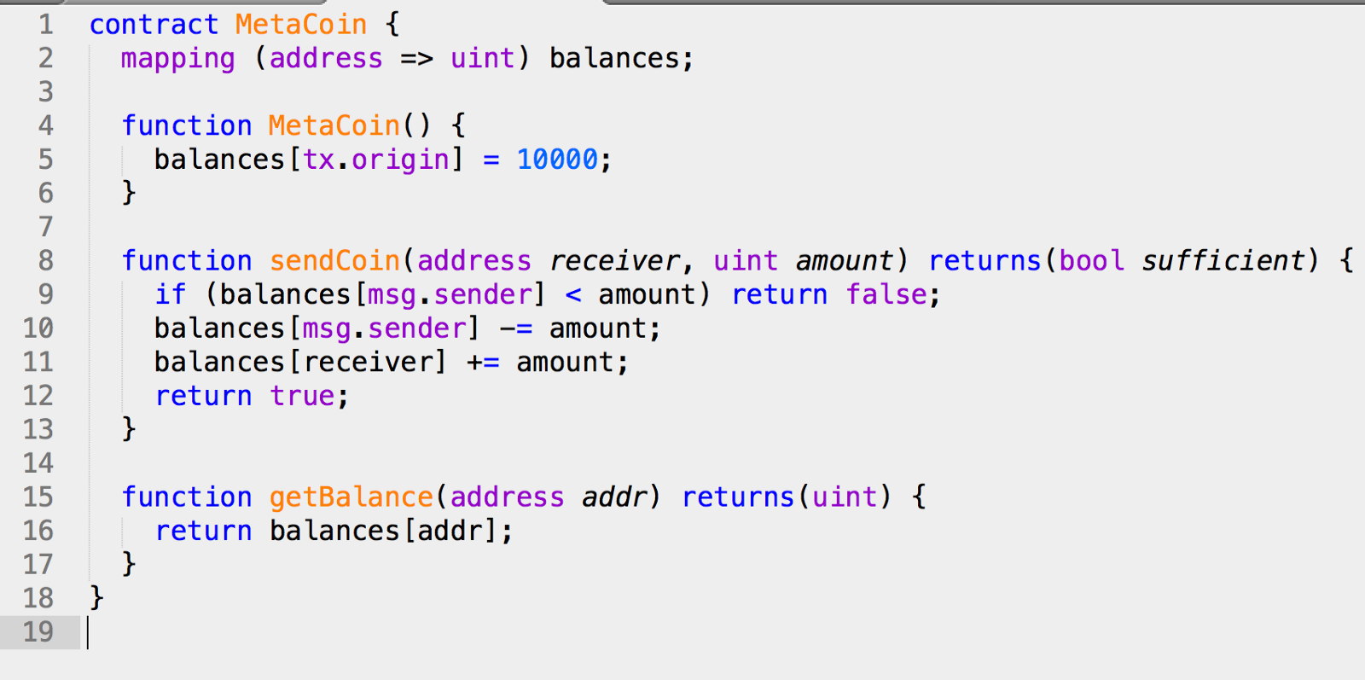
Ethereum and it’s advances
ÐApps (https://www.stateofthedapps.com/)
Smart Contracts
A dedicated team to work on the network (Could be considered centralized)
Casper (Proof of Stake)
Swarm
Sharding/Plasma

Slide 34
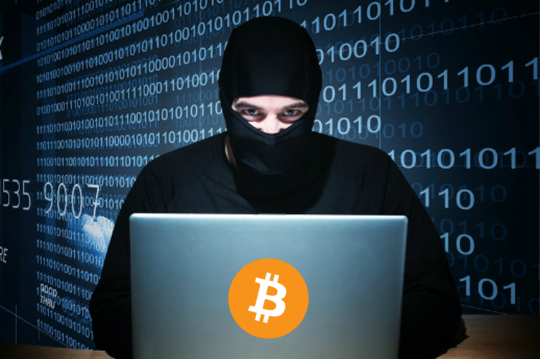
Issues facing blockchain today
Illegal use
Scalability
Mass adoption
Privacy

Slide 35
So why does it matter?
The potential is astronomical, assuming key issues are resolved.
Can culturally and economically change the world financial system
Has helped to stabilize some third-world country economies (somewhat)
Could potentially eliminate the need for locally hosted servers and massive, insecure, controlled databases

Slide 36

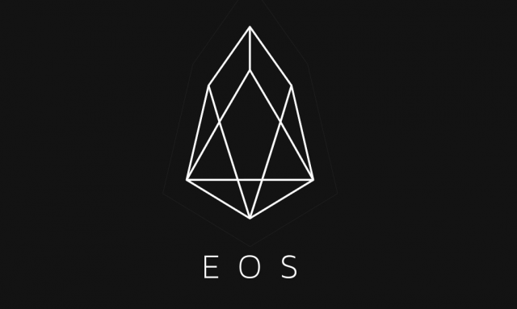

What can you do with this?
Web 3.0- programs can be run on the blockchain
Create a node- participate in the network through mining
Create products using the blockchain (https://etherscan.io/tokens) e.g GOLEM

